Slide 1
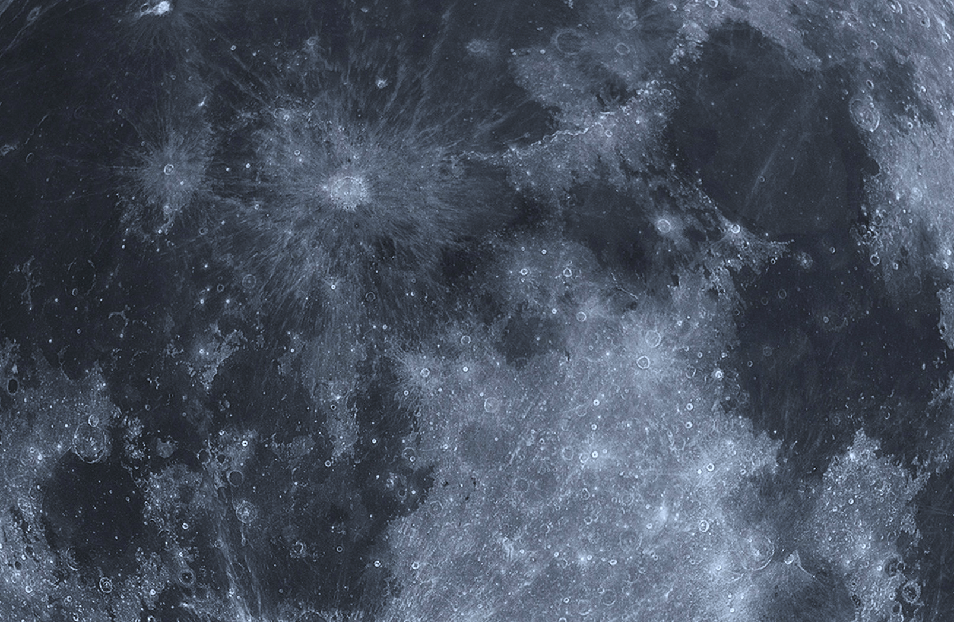
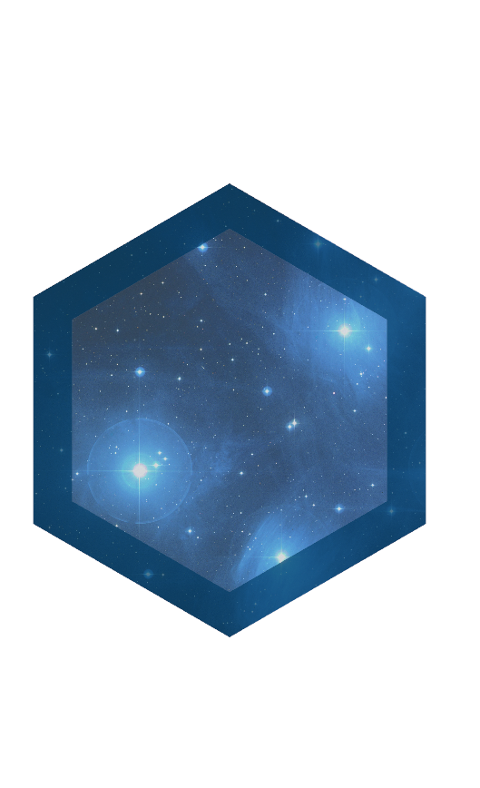
Observatory
Maximilian Zavodny
(626)437-7334
max46145@gmail.com

Slide 2
Motivation
Data visualization: the ultimate brain hack
Existing tools are lacking
Real-time interactions are unnatural or unintuitive
APIs are confusing, clunky, and complicated
Customizability is limited
Rendering performance is poor
Aesthetic appearance is often poor

Slide 3
Solution: Observatory
Fresh environment, rebuilt from scratch
Directly references OpenGL
No limiting intermediate libraries
Video-game caliber rendering performance
C# source code, runs on .NET
Also runs on Mono and soon, in browsers
Includes APIs for .NET, Python, and MATLAB
Maybe JavaScript and others someday

Slide 4
Demos
Meteorite map
Extrasolar planet population
3D model of the brain
Southern Oscillation Index
Numerical Image

Slide 5
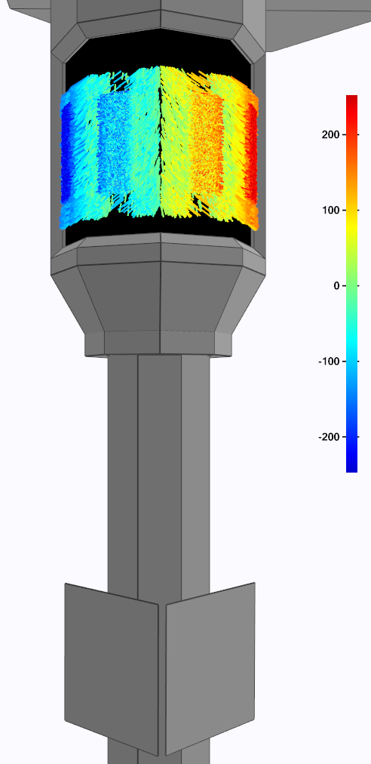
Project Status
Fully-featured, available for download
Immediately ready for users
Max is sole contributor; no outstanding liabilities or obligations
Proven value at eSolar
First deployed Fall 2014
Up to ~10 active users
Time-sensitive, mission-critical analysis
Auto-generated reports to management
Source material for executive presentations, publications, etc.
Recent work: interoperability
Python/MATLAB APIs
WebGL/browser compatibility

Slide 6
Expertise Needed
Sales & Marketing
Business experience, end-user software
Legal counsel
esp. IP protection, license terms
Down the road…
Tech support, QA
Experienced Linux/Mac/Web developers

Slide 7
Potential business models
Individual user and/or organization licenses
Offer free limited-feature version; charge for premium features
Use as foundation for application/project-specific libraries
License as add-on to existing software packages
Develop team to offer consulting on a project-basis

